Slide 1


Slide 2
Contents
Data at whole population level
Demographic groups
Triple demographic groups
Activities
What the data is telling us

Slide 3
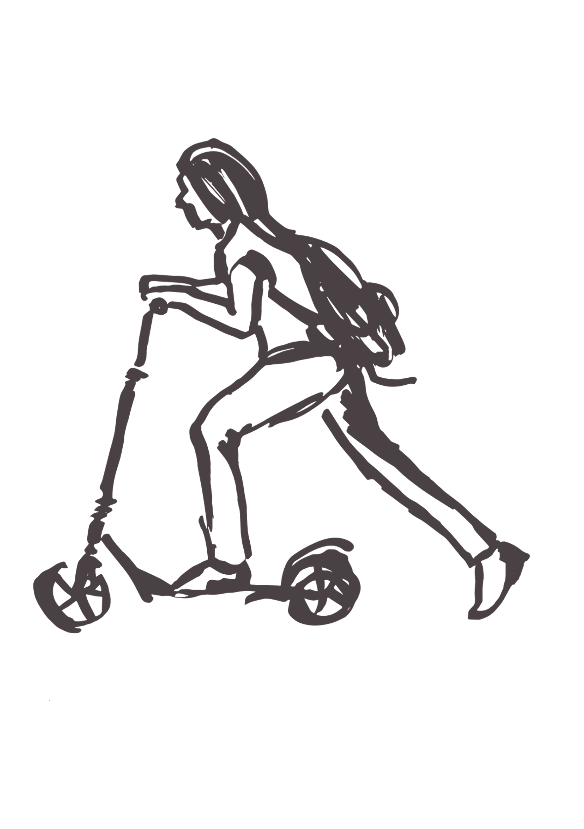
Data at whole population level

Slide 4
Over half our CYP are not doing enough physical activity
Source: Active Lives Children and Young People Survey 2017-21

Slide 5

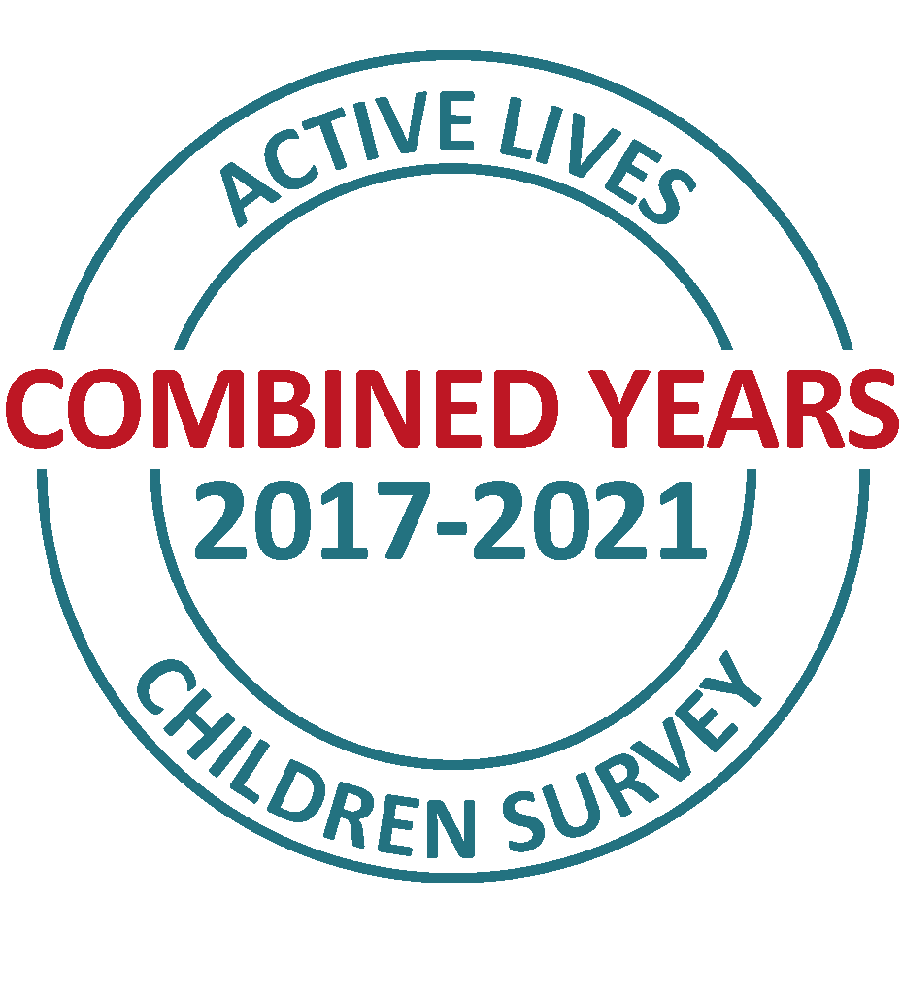
Demographic groups
Note that we’ve had to aggregate the data in places as the sample size is not large enough. For example, to analyse physical activity behaviour by 6 ethnicity groupings in the year 2020-21
Instead, we have combined 4 years of data to give a larger sample size

Slide 6
Girls, children in low affluence families and in years 3-4 experience lower levels of activity
Source: Sport England Active Lives Children and Young People Survey 2017-21 combined

Slide 7
Asian CYP experience lower levels of activity
Source: Sport England Active Lives Children and Young People Survey 2017-21 4 years combined

Slide 8
Inequalities exist at school…
Source: Sport England Active Lives Children and Young People Survey 2017-21 combined

Slide 9
And outside of school
Source: Sport England Active Lives Children and Young People Survey 2017-21 combined

Slide 10
The pandemic has had a greater negative impact on the activity levels boys than girls
Source: Active Lives Children and Young People Survey 2017-21
Notes:
The charts are showing the percentage of those who meet the CMO guidelines for being ‘active’:
Everywhere = 60 mins
At school = 30 mins
Outside school = 30 mins

Slide 11
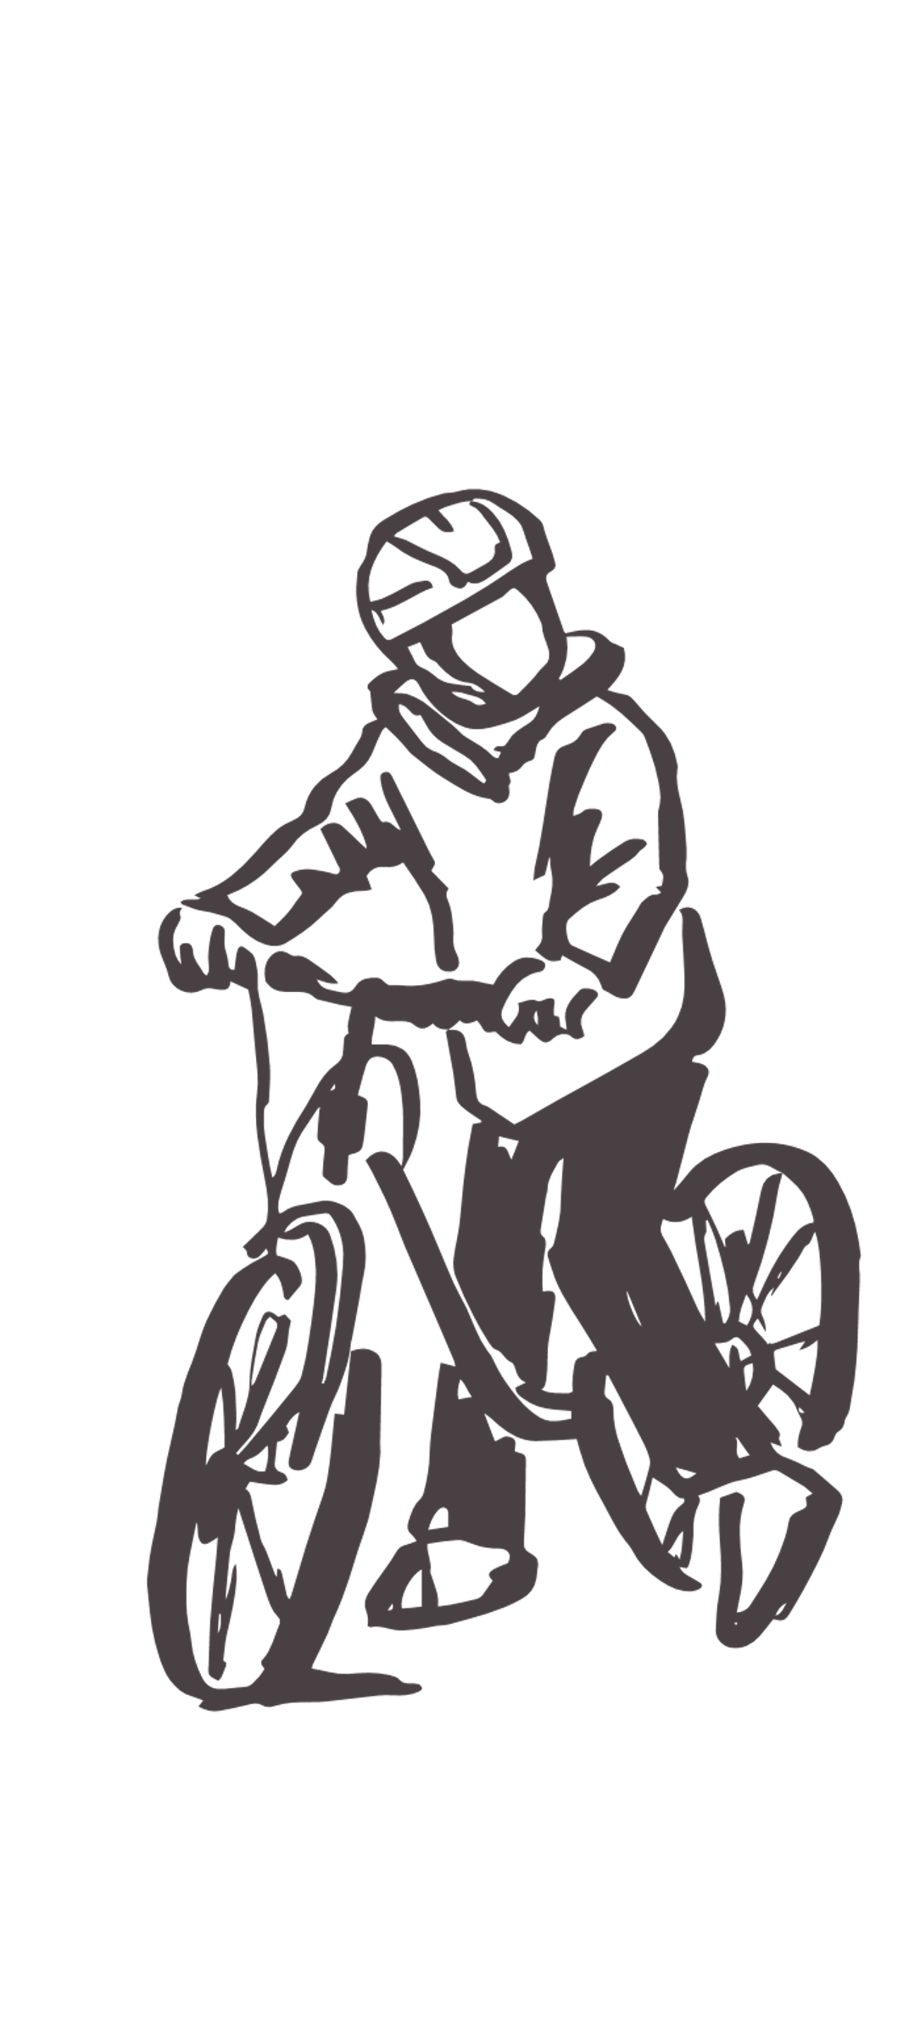
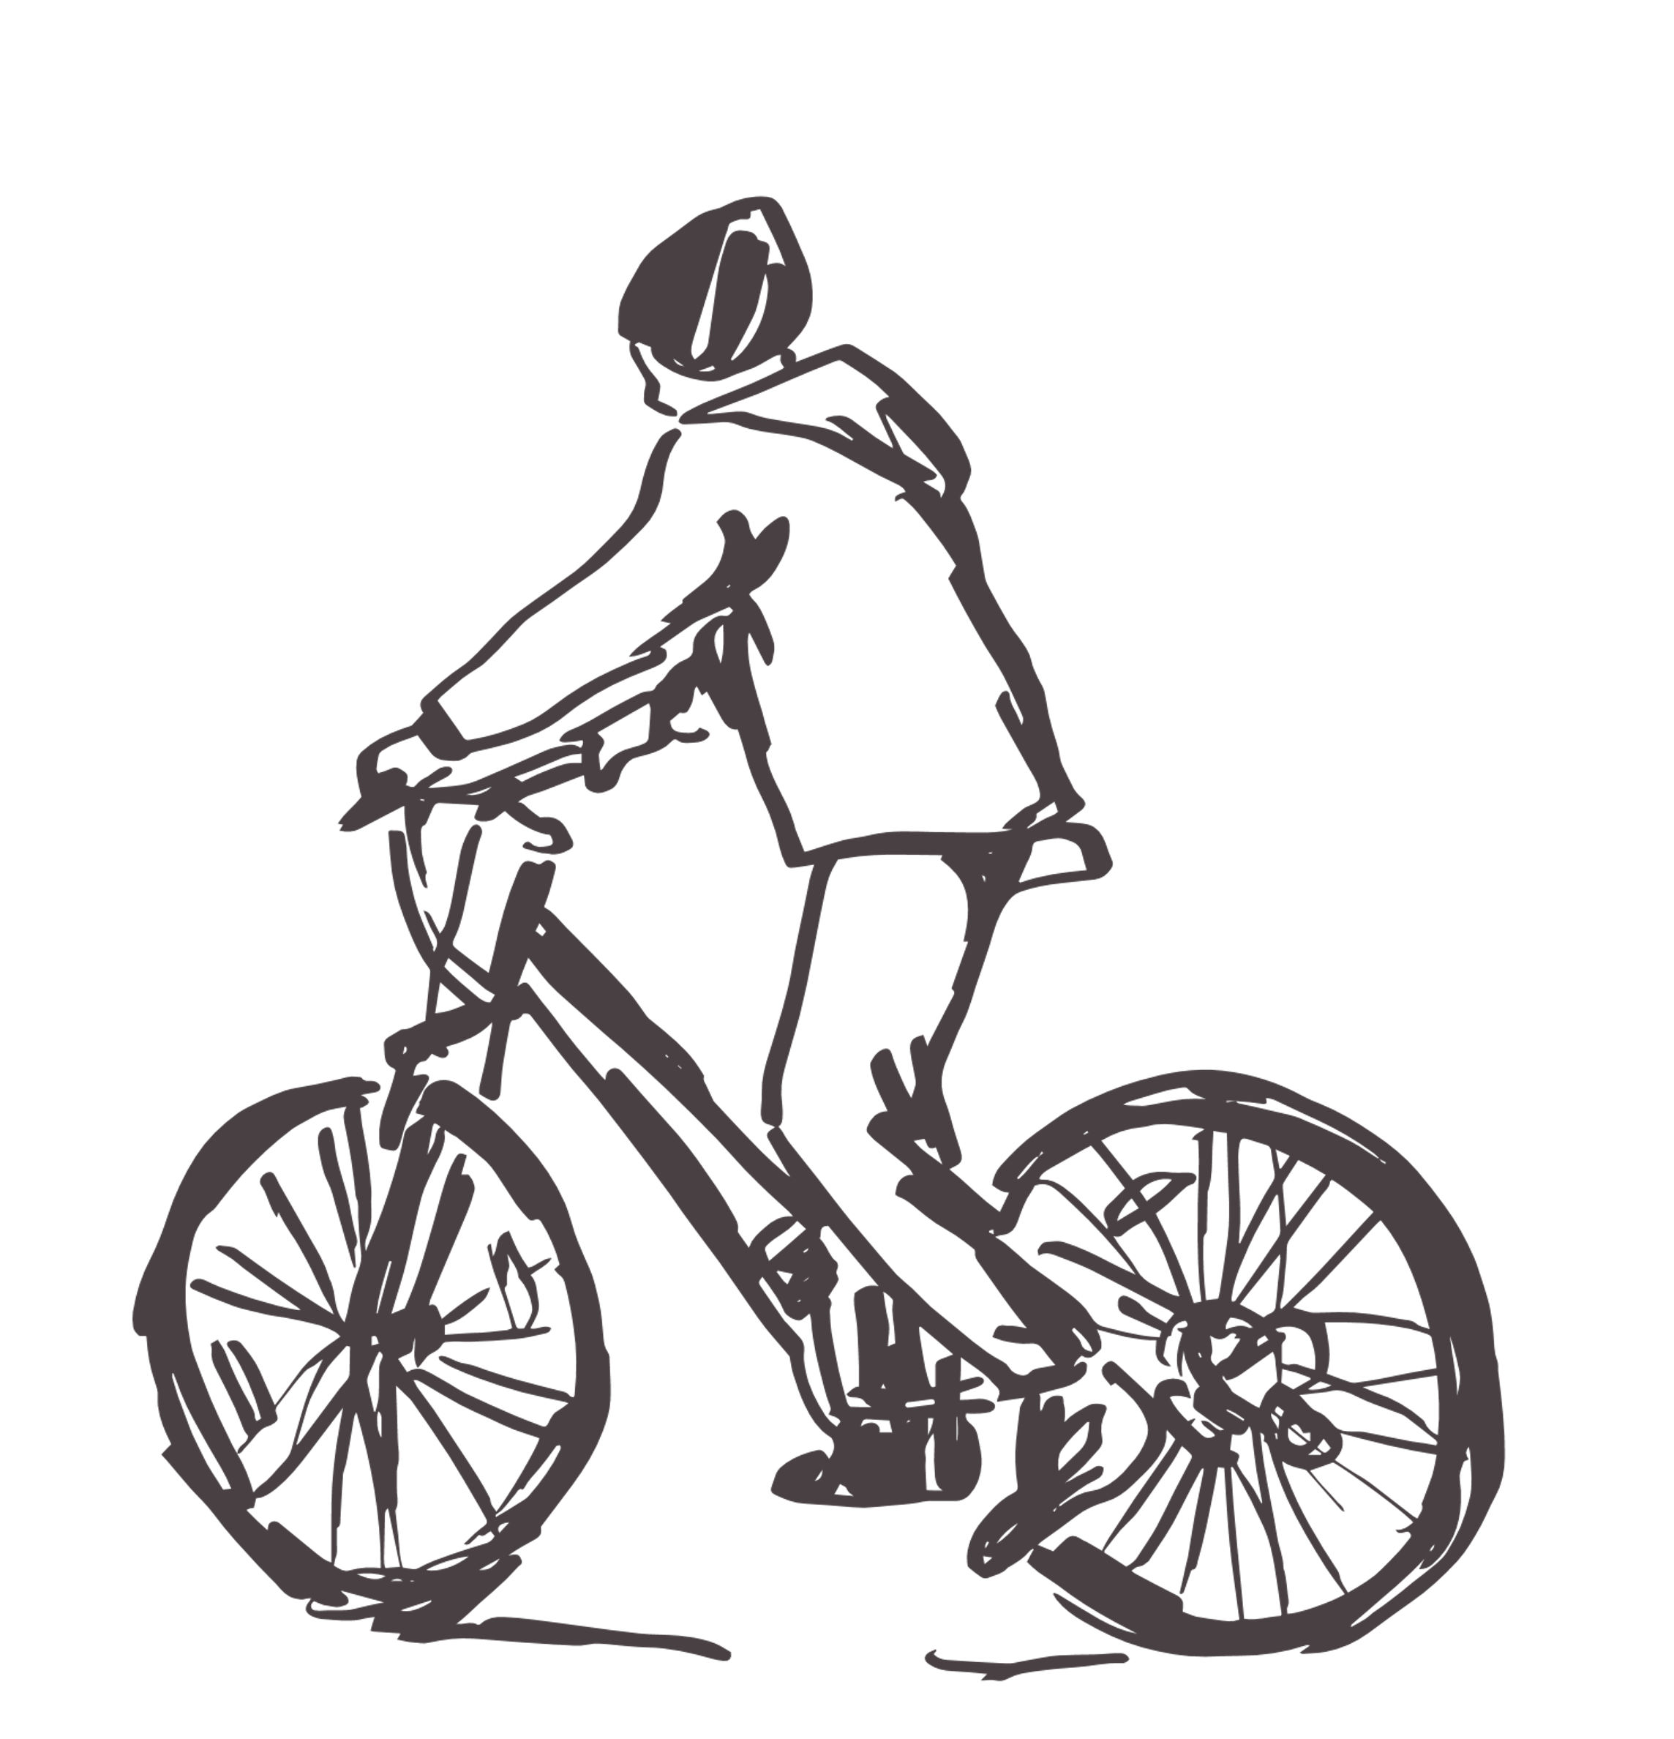
Triple demographic groups
In this section we show analysis by all three of the following demographics:
Year groups
Gender
Family affluence
Again, we have combined 4 years of data to boost the sample size for these groups

Slide 12
There seems to be greater inequality between boys and girls in years 3-6
Source: Sport England Active Lives Children and Young People Survey 2017-21 4 years combined
Notes:
Percentage who are active: Achieving an average of 60 minutes or more a day
Combined sample size: Wesport
All CYP 1,175
Low FAS Boy 100
Low FAS Girl 112
Medium FAS Boy 342
Medium FAS Girl 327
High FAS Boy 166
High FAS Girl 128

Slide 13
Children in low affluence families experience lower levels of activity between ages 11 and 16
Source: Sport England Active Lives Children and Young People Survey 2017-21 4 years combined
Notes:
Percentage who are active: Achieving an average of 60 minutes or more a day

Slide 14
Though the inequality is wider outside of school
Source: Sport England Active Lives Children and Young People Survey 2017-21 4 years combined
Notes:
Where ‘active’ is an average of 30 minutes or more a day (in the specified setting)

Slide 15
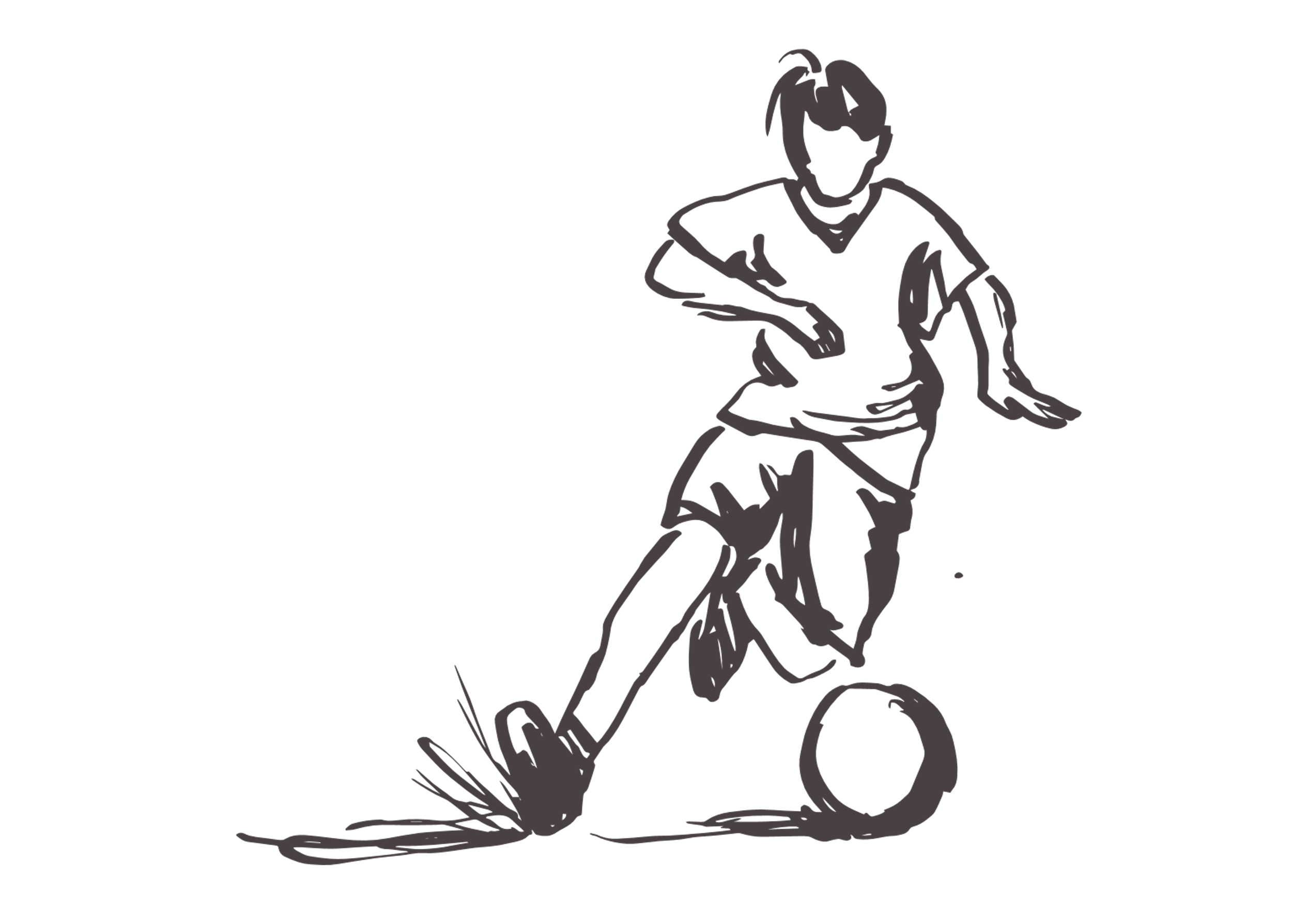
Activities
In this section we analyse the types of activities children and young people were doing in a given week
Data is for any duration, with at least moderate intensity

Slide 16
The pandemic is impacting on how CYP get their minutes
Fitness activities
Dance
Walking for leisure
Active play
Walking for travel
Cycling & scooting
Sporting activities
Source: Sport England Active Lives Children and Young People Survey 2017-21
Notes:
Note: Respondents were asked how long they spent doing different activities the last time they did the activity. When this was not available, standard rules based on activity, school year and whether in or out of school were used to calculate the minutes spent. The minutes were based on feedback from an objective measurement study and responses given by those who did answer minutes questions. Information provided by teachers about the length of PE lessons, breaks times and school clubs was also used to guide at school activity duration assumptions.
More information on the full assumptions are in the document: Active Lives Child Code Book Year 3 (2019-20) v1

Slide 17
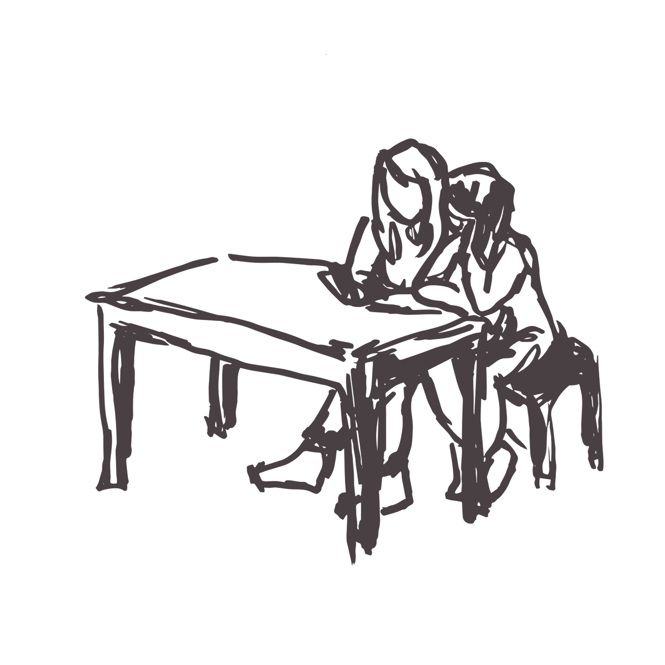
What the data is telling us

Slide 18
The story so far
Summary
Over half our CYP are not doing enough physical activity to benefit their health – 3 in 10 are less active
Girls, children in low affluence families and in years 3-4 and 9-11 experience lower levels of activity
Asian CYP also experience lower levels of activity
Inequalities exist at school… And outside of school
The pandemic has had a greater negative impact on the activity levels boys than girls
There seems to be greater inequality between boys and girls in years 3-6
Children in low affluence families experience lower levels of activity between ages 11 and 16 though the inequality is wider outside of school
Questions
How much focus is there on CYP activity levels across UAs and upon the groups experiencing lower activity levels?
What do we know about the inequalities that are at play ‘in school’? What factors are causing these? How aware are schools of the situation?
Though the data is limited, it seems that the gender inequality is greater in primary school aged children than secondary, why is this?
The pandemic is impacting on how children get their minutes, what might the long term implications of this be?

