Slide 1
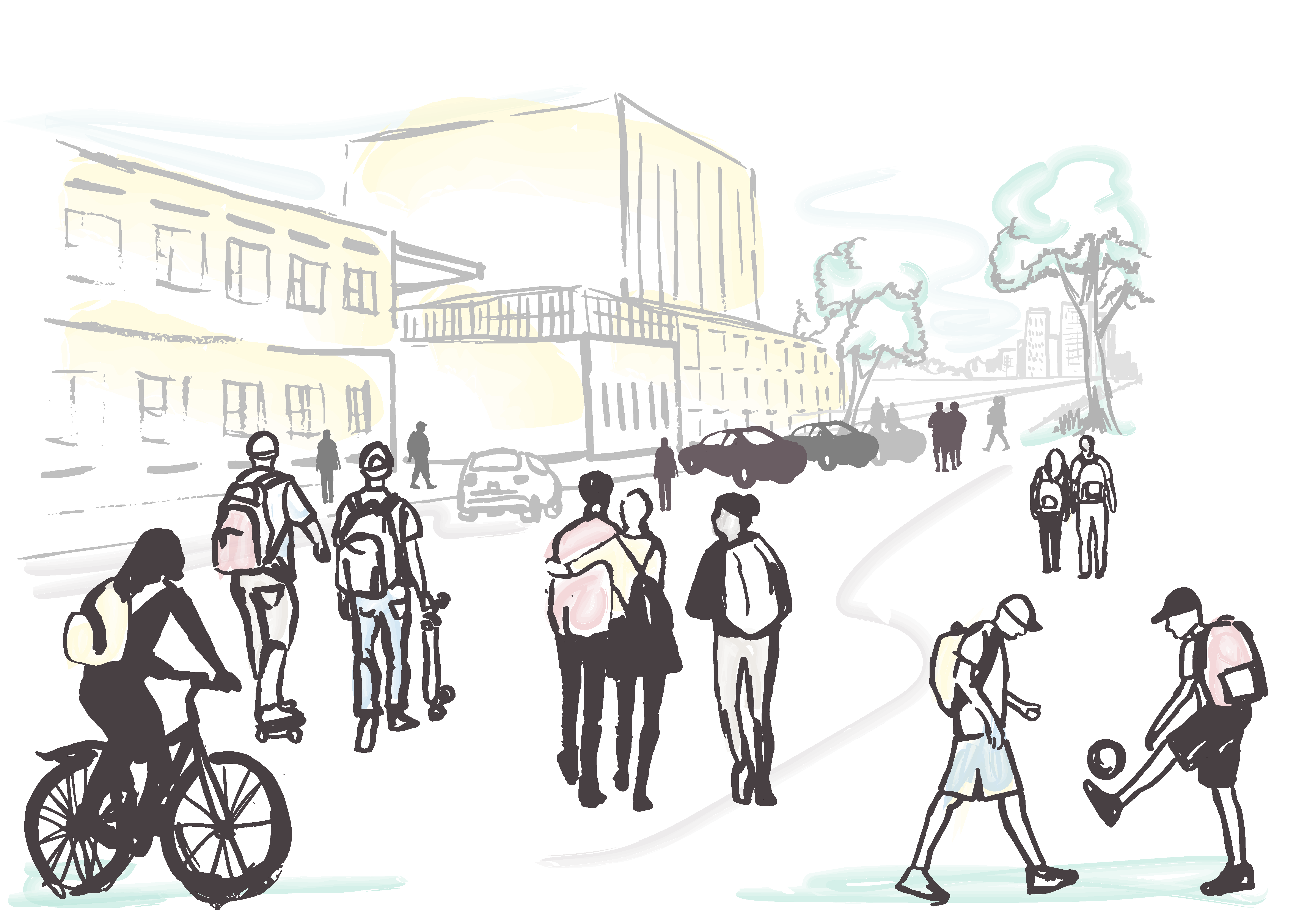


Children & Young People Physical Activity Behaviour
Active Lives
Children’s Survey
21-22

Slide 2
The Active Lives Survey: Children and Young People gathers data on how children engage with sport and physical activity
Designed by Sport England, the Department for Education (DfE), the Department for Health (DfH), and the Department for Digital Culture Media and Sport (DCMS), its purpose is to gain a detailed insight into the current physical activity habits of the nation's children and young people (aged 5 to 16).
The survey collects data to present a comprehensive picture of children and young people’s:
Overall levels of activity both during the school day (‘at school’) and outside school
Activity levels for a range of key demographic groups
The types of activities undertaken by age group
Volunteering levels (supporting sport and physical activity)
Associations between activity levels and measures of mental wellbeing, individual development and social and community development
Attitudes towards sport and physical activity
For more information about the survey please visit Sport England's website
Notes:
The results presented are year 5 (21/22 academic year). Since the year 1 data was published, there’s been a change to the UK Chief Medical Officer’s physical activity guidelines for children and young people. Instead of at least 60 minutes of activity every day, the new guidelines recommend young people engage in moderate to vigorous intensity activity for an average of at least 60 minutes a day across the week. The data for all years is now presented to reflect this change in guidelines.

Slide 3
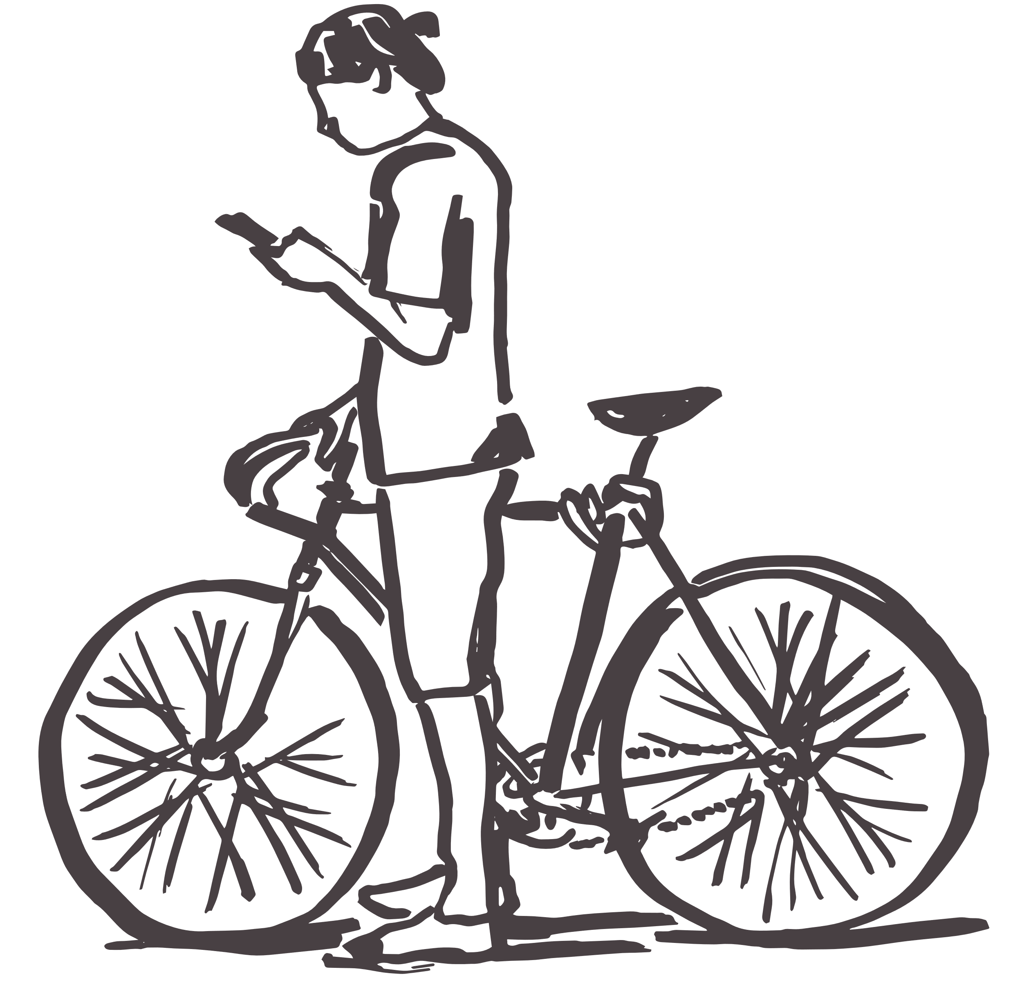
How much physical activity should children and young people do?
The Chief Medical Officer’s (CMO) guidelines for young people is presented in three categories for overall activity in the last week:
Active
An average of 60 minutes or more a day
(at least 420 mins over a week).
The majority of the data in this data pack will focus on this
Fairly active
An average of 30-59 minutes a day
Less active
Less than an average of 30 minutes a day
Note: Only activity of at least moderate intensity is included
Notes:
The data in this document is for children and young people aged 5-16 but the guidelines are set for 5-18 year olds. 16-18 year olds are included in the Adult Active Lives survey

Slide 4
Definitions
Family affluence score (FAS)
This is a standard scale developed for the Health Behaviour in School Aged Children Survey (an international study of 11-15 year olds) which involves asking a series of questions and provides an overall score between 0-13:
Low family affluence (score range 0-6)
Medium family affluence (score range 7-10)
High family affluence (score range 11-13)
Moderate intensity activity
Is defined as activity where you raise your heart rate and feel a little out of breath (children were asked whether it made them breathe faster)
Percentage points (pp)
A percentage point (pp) is the unit for the arithmetic difference of two percentages (%). For example, moving up from 40% to 44% is a 4pp increase, but is a 10% increase in what is being measured
Income deprivation affecting children
This is derived from the Index of Income Deprivation Affecting Children (IDACI) which comes under the Index of Multiple Deprivation Outputs but is based on income source data only. It is matched onto the data using the postcode of the school attended by the pupil. Deciles 1-4 are grouped as ‘deprived’ deciles 8-10 are grouped as ‘affluent’
Limiting disability
Whether or not a young person has a disability, special need or illness. This measure changed in 19-20

Slide 5
Definitions continued
Everywhere*
This refers to activities done in and out of school (see definitions below). The active total for ‘At school’ and ‘Outside school’ does not equal ‘Everywhere’ as some children will be active at both settings but will only count once in ‘Everywhere’.
At school Where every day = five days (weekdays only)
Refers to activities done while at school, during normal school hours. It includes activities in PE lessons and break times, but excludes activities at before and after school clubs, even if these take place at school
Outside school Where every day = seven days
Refers to activities done outside of school hours. It includes anything done before getting to school and after leaving school (including travel to/from), as well as activity done at the weekend, on holiday days and at before and after school clubs, even if these took place at school
*Unless otherwise stated, data in this pack is for ‘Everywhere’

Slide 6
National headlines
Full report – available in full here - covers the 2021-22 academic year.
The findings paint a promising picture, with a return to levels seen pre-pandemic in the proportion of children and young people meeting the Chief Medical Officers’ guidelines of taking part in an average of 60 minutes or more of sport and physical activity a day.
There are also positive signs of longer-term growth in activity levels among secondary aged girls (ages 11-16). However, some groups are being left behind, with primary aged children, specifically those in school Years 3-4 (ages 7-9), and Black boys, not seeing the same recovery - while Black girls are reporting significantly fewer positive attitudes towards sport and physical activity than before the pandemic.
The survey provides more evidence as to the positive impact of physical activity on mental health - with an increase in the proportion of children exercising to relax and worry less, and socially for fun with friends.
However, physical literacy levels - which are linked to higher levels of activity and wellbeing - haven’t recovered to pre-pandemic levels. It’s therefore vital there’s a focus on providing positive experiences of physical activity, with children and young people involved in decisions around their design and delivery. And while activity levels are recovering, there are warning signs that more needs to be done - with the ongoing challenges of the cost of living posing a risk to continued recovery and growth.

Slide 7
National demographics
The proportion of children and young people classified as active has returned to pre-pandemic levels across most age groups.
However this isn’t the case for those in school Years 3-4 (ages 7-9) where activity remains 4.5%, or 53,000 children, down on pre-pandemic (academic year 2018-19), with no change compared to 12 months ago.
In contrast, young people in school Years 9-11 (ages 13-16) have seen activity levels increase above pre-pandemic levels (up 5.7%/145,000 young people) and in line with the highs seen two years ago
When looking at gender, boys have driven the recovery in activity levels, with the proportion active now back in line with pre-pandemic (academic year 2018-19). Girls continue to see limited change overall, although levels are slightly above pre-pandemic (up 1.9%, or 98,000 more active girls). As a result, the gender gap between boys and girls has re-emerged - with a gap of 5% between them in the proportion active. This overall picture masks some clear and important differences between age groups:
  The lack of recovery seen across children in Years 3-4 (ages 5-7) is seen for both boys and girls, but boys in school Years 5-6 (ages 7-9) have seen limited recovery.
  While secondary age boys are following the pattern seen here for boys overall, secondary age girls are showing some growth in activity levels.
  There’s a much smaller gender gap among secondary age young people (school Years 7-11, ages 11-16), with just 2% between them.
There’s an emerging upward trend in activity levels among girls in school Years 7-8 (ages 11-13), with an increase of 5.7%, or more than 50,000, more active young people since academic year 2017-18. Additionally, girls in school Years 9-11 (ages 13-16) saw an increase in academic year 2019-20, which has been consolidated giving them a net overall increase of 11.5%, or more than 100,000, more active young people compared to pre-pandemic

Slide 8
National – demographics continued
The proportion of children and young people without a disability or long-term health condition, who are active, has increased compared to 12 months ago. This is in line with the overall change in children and young people’s activity levels. While we can’t detect a change for those with a disability or long-term health condition, activity levels overall remain consistent between the two groups.
Activity levels are back in line with those seen pre-pandemic (academic year 2018-19) for all ethnic groups, with the exception of Black children and young people. This is specifically among Black boys where, despite a notable increase compared to 12 months ago, the proportion active remains 7.7% lower than pre-pandemic. The gender gap remains widest between Asian girls and boys (10%), followed by Black (8%) and Other (8%) children and young people.
When taking family affluence score into consideration, children and young people from the least affluent families are the least likely to be active, with only 42% meeting the Chief Medical Officers’ guidelines - compared to 52% of those from the most affluent families. The overall impact of the pandemic on activity levels was similar across groups and all have similarly recovered to pre-pandemic levels.
Deprivation affects activity levels. They are lowest among those going to school in the most deprived places in the country. Despite an increase compared to 12 months ago, those going to school in the most deprived places haven’t seen activity recover to pre-pandemic (academic year 2018-19) levels, with the proportion active remaining down by 2.8%. As such, the gap in activity levels between those going to school in the least and most deprived places has widened.

Slide 9
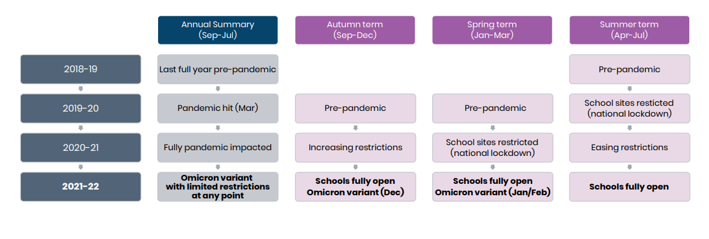
Covid-19 timeline and data reference points
This release contains a full year’s data following the removal of most legal restrictions related to Covid-19, however it does contain the period where the Omicron variant was of concern.
Comparisons are generally made with academic year 2020-21 (12 months ago), where some form of disruption was seen throughout the year with restrictions and school closures occurring, and to academic year 2018-19 as the last full year’s data pre-pandemic.
Full details of lockdowns and measures between March 2020 and December 2021 can be found here

Slide 10
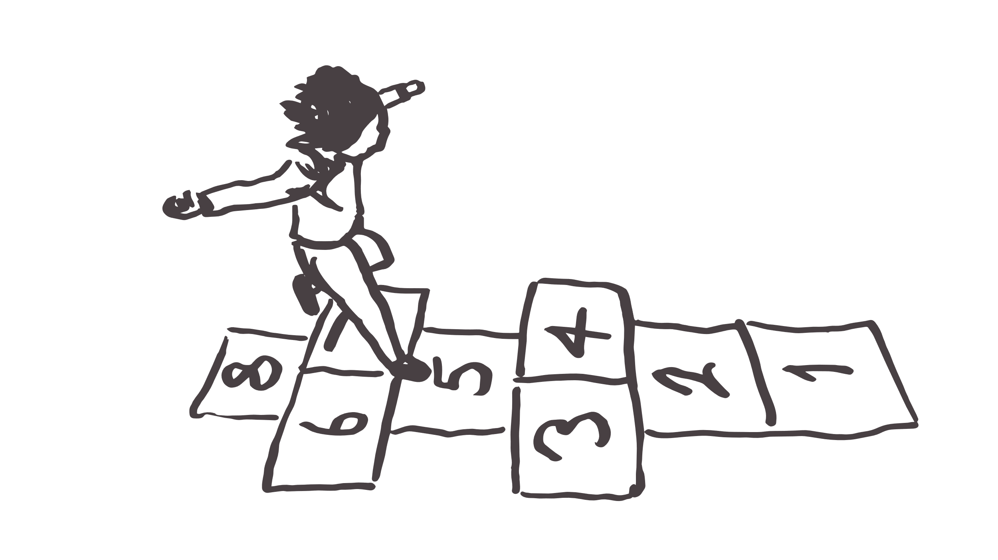
How to read the charts

Slide 11
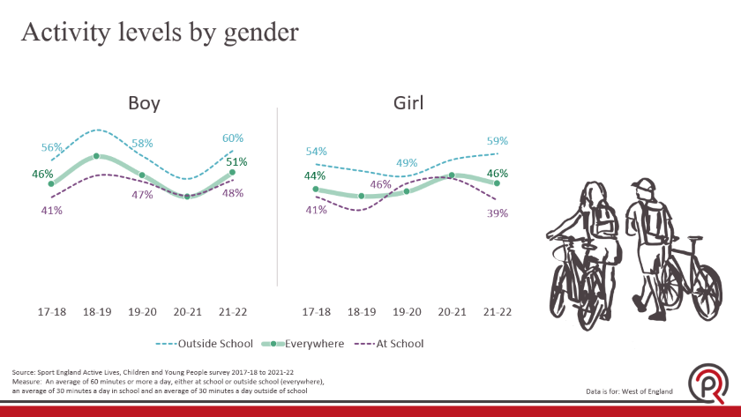
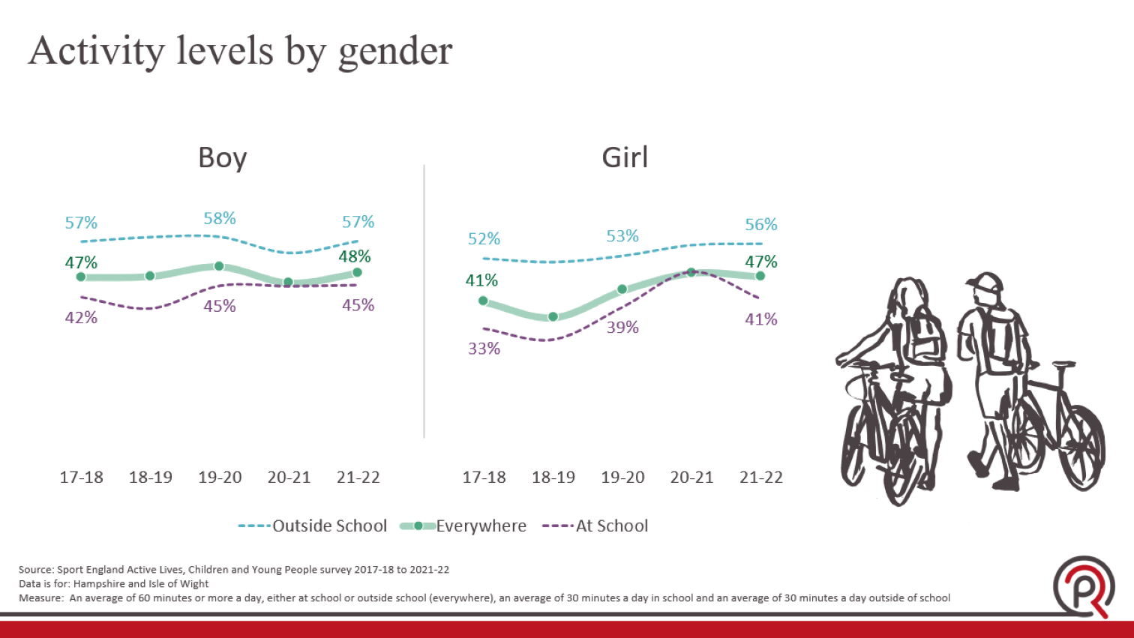
How to read the charts: Activity levels
Everywhere (solid green line)
This refers to activities done in and out of school
Outside school (dotted blue line)
Refers to activities done while at school, during normal school hours
At school (dotted lilac line)
Refers to activities done outside of school hours
Note: ‘At school’ and ‘Outside school’ does not equal ‘Everywhere’ as some children will be active at both settings but will only count once in ‘Everywhere’.

Slide 12
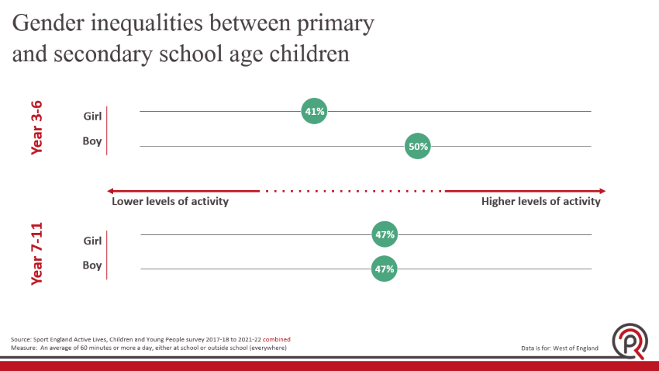
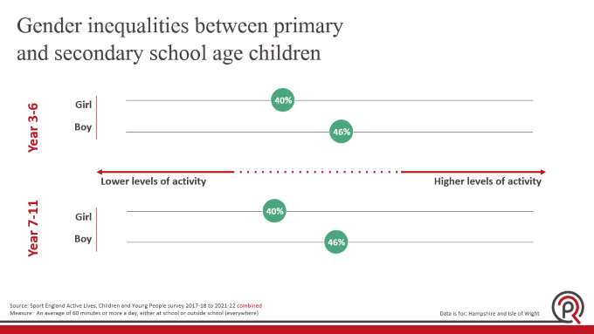
How to read the charts: Inequalities (second demographics)
The green bubbles indicate active levels (everywhere) for demographic groups (in this example, gender) split by primary and secondary school age children
The distance between the dots on each chart indicates the inequality (eg girl 40%, boy 46% = a gender inequality gap of 6pp)
The distance between the relative dots on corresponding charts indicates the inequality between primary and secondary age girls and boys
Note: Higher levels of activity are better than lower levels of activity

Slide 13
Sample sizes by survey year and demographic group
 | 17-18 | 18-19 | 19-20 | 20-21 | 21-22
Total responses | 1,410 | 1,029 | 665 | 589 | 954
Boy | 620 | 506 | 289 | 282 | 469
Girl | 691 | 441 | 317 | 263 | 370
Year 1 -2 (parent) | 31 | 27 | 10 | 40 | 59
Year 3-4 | 264 | 143 | 50 | 129 | 135
Year 5-6 | 275 | 156 | 54 | 193 | 79
Year 7-8 | 348 | 416 | 258 | 103 | 243
Year 9-11 | 492 | 287 | 293 | 124 | 438
Has limiting disability | - | - | 32 | 30 | 78
No limiting disability | - | - | 463 | 383 | 585
Low FAS | 224 | 160 | 75 | 122 | 141
Medium FAS | 783 | 542 | 341 | 347 | 561
High FAS | 337 | 271 | 203 | 84 | 165
White British | 1,031 | 737 | 360 | 451 | 668
White Other | 72 | 24 | 54 | 23 | 44
Asian | 65 | 39 | 86 | 9 | 52
Black | 39 | 53 | 35 | 15 | 20
Mixed | 88 | 58 | 47 | 23 | 42
Other ethnicity | 71 | 25 | 18 | 18 | 29
Source: Sport England Active Lives, Children and Young People survey 2021-22
Measure: All respondents, Sample sizes must be 150+ to be included in the analysis
Data is for: West of England
Notes:
The disability questions were changed in 19-20, the survey is not asked in SEN schools
Non compulsory survey questions
Where there appears to be low sample sizes or a discrepancy in the data, this could be explained by some CYP opting to leave some non compulsory survey questions blank. For example, it is no longer mandatory to complete the ‘gender’ question.

Slide 14
Over half of our children
are not active enough
Source: Sport England Active Lives, Children and Young People survey 2021-22
Measure: An average of 60 minutes or more a day, either at school or outside school (everywhere)
Data is for: West of England

Slide 15
Activity levels have recovered to pre-pandemic highs
Source: Sport England Active Lives, Children and Young People survey 2017-18 to 2021-22
Measure: An average of 60 minutes or more a day, either at school or outside school (everywhere)
Data is for: West of England

Slide 16
Physical activity levels by local authority
Source: Sport England Active Lives, Children and Young People survey 2021-22
Measure: An average of 60 minutes or more a day, either at school or outside school (everywhere)
Data is for: West of England
Notes:
Sample sizes:
West of England 954
Bath and North East Somerset 0
Bristol, City of 229
North Somerset 133
South Gloucestershire 592

Slide 17
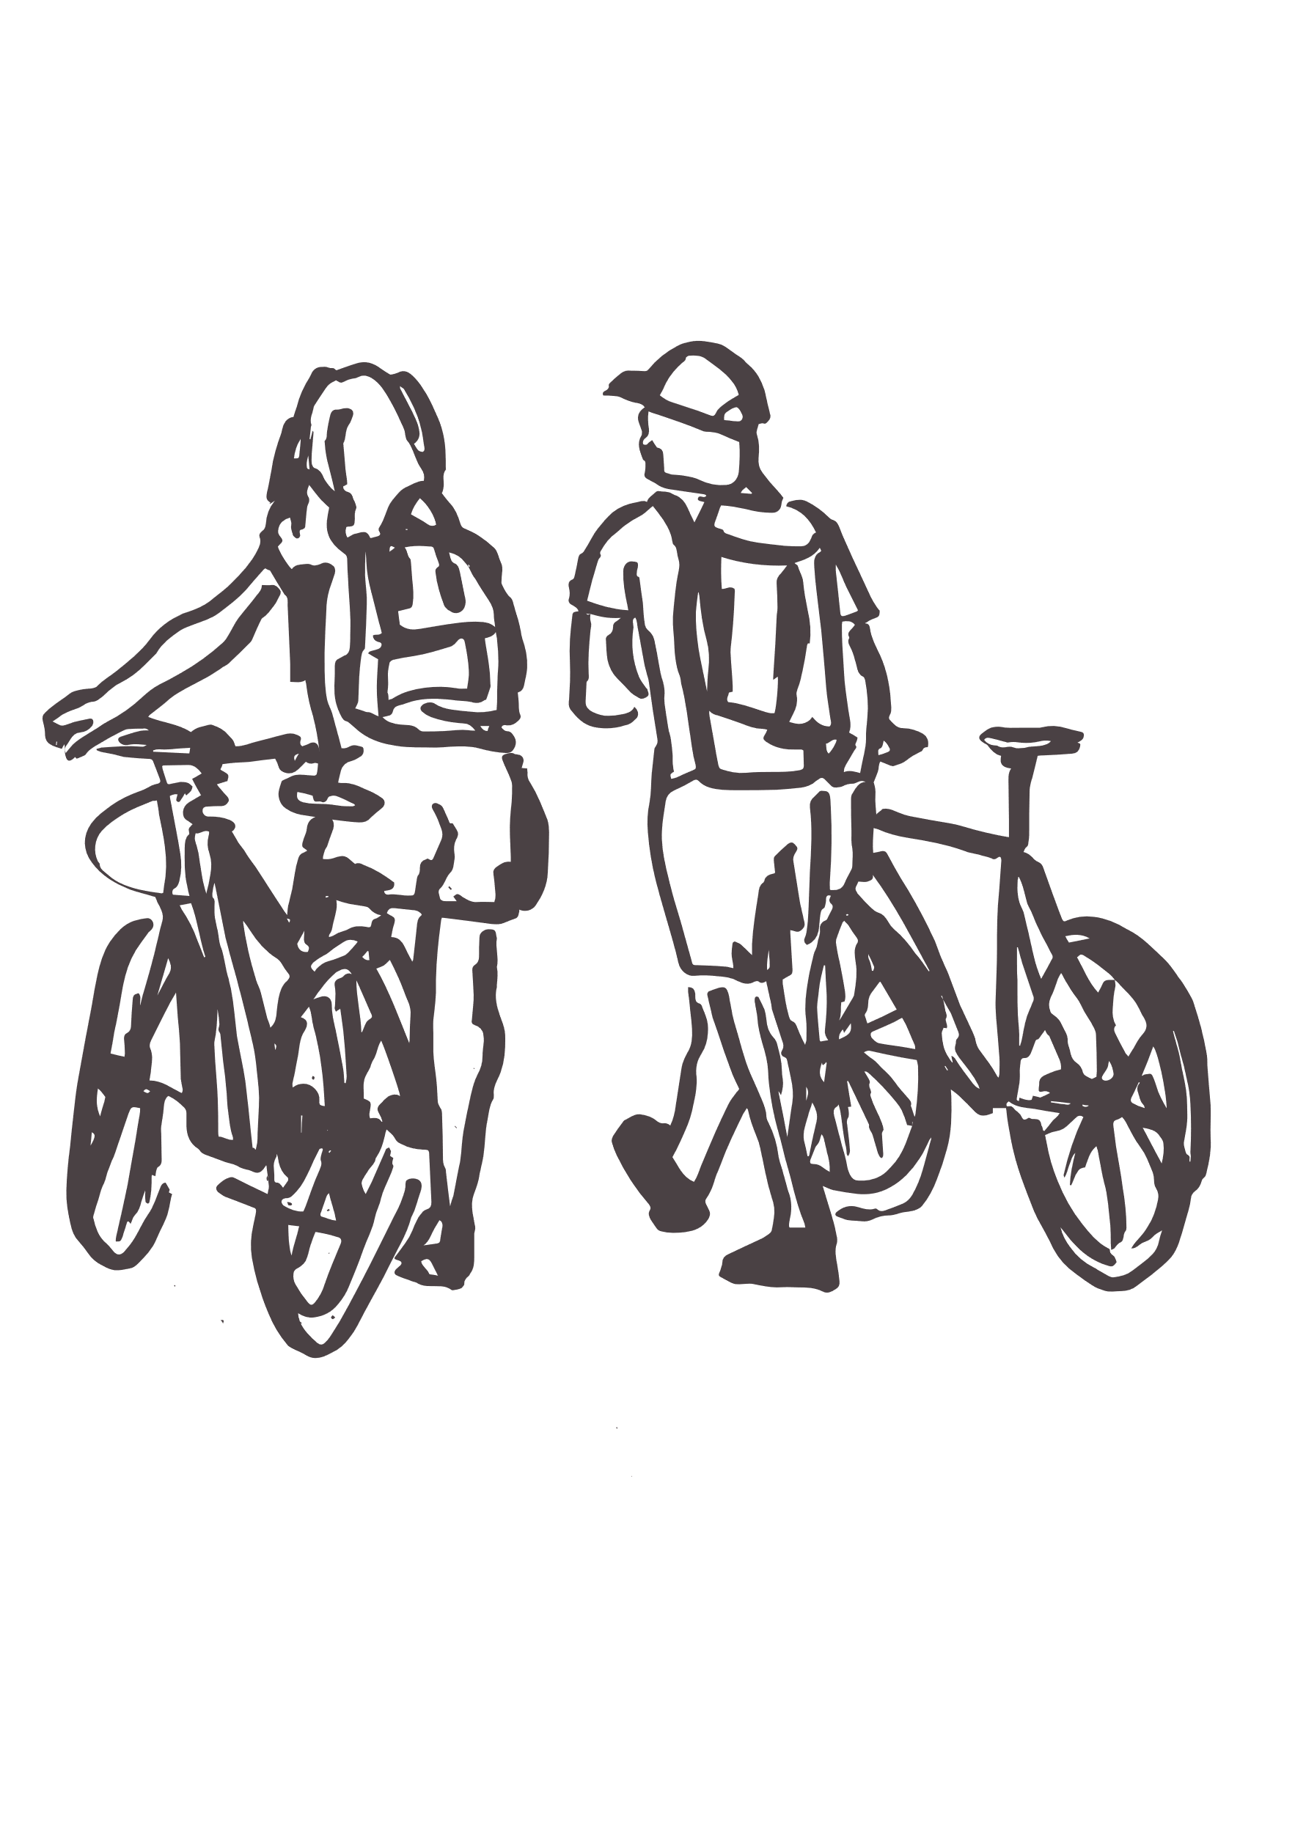
Activity levels by gender
Source: Sport England Active Lives, Children and Young People survey 2017-18 to 2021-22
Measure: An average of 60 minutes or more a day, either at school or outside school (everywhere), an average of 30 minutes a day in school and an average of 30 minutes a day outside of school
Data is for: West of England

Slide 18
Activity levels by school age
Source: Sport England Active Lives, Children and Young People survey 2017-18 to 2021-22
Measure: An average of 60 minutes or more a day, either at school or outside school (everywhere), an average of 30 minutes a day in school and an average of 30 minutes a day outside of school
Data is for: West of England
Notes:
Sample Size 17-18 18-19 19-20 20-21 21-22
Primary (years 3-6) 539 299 104 322 214
Secondary (years 7-11) 840 703 551 227 681

Slide 19
Activity levels peak between years 5 and 9
Source: Sport England Active Lives, Children and Young People survey 2017-18 to 2021-22 combined
Measure: An average of 60 minutes or more a day, either at school or outside school (everywhere)
Data is for: West of England
Notes:
Sample sizes
Year 1 (parent) 78
Year 2 (parent) 89
Year 3 299
Year 4 422
Year 5 395
Year 6 362
Year 7 803
Year 8 565
Year 9 662
Year 10 577
Year 11 395

Slide 20
Activity levels by family affluence
Source: Sport England Active Lives, Children and Young People survey 2017-18 to 2021-22
Measure: An average of 60 minutes or more a day, either at school or outside school (everywhere), an average of
30 minutes a day in school and an average of 30 minutes a day outside of school
Data is for: West of England
Notes:
Sample Size 17-18 18-19 19-20 20-21 21-22
Low FAS 224 160 75 122 141
Medium FAS 783 542 341 347 561
High FAS 337 271 203 84 165

Slide 21
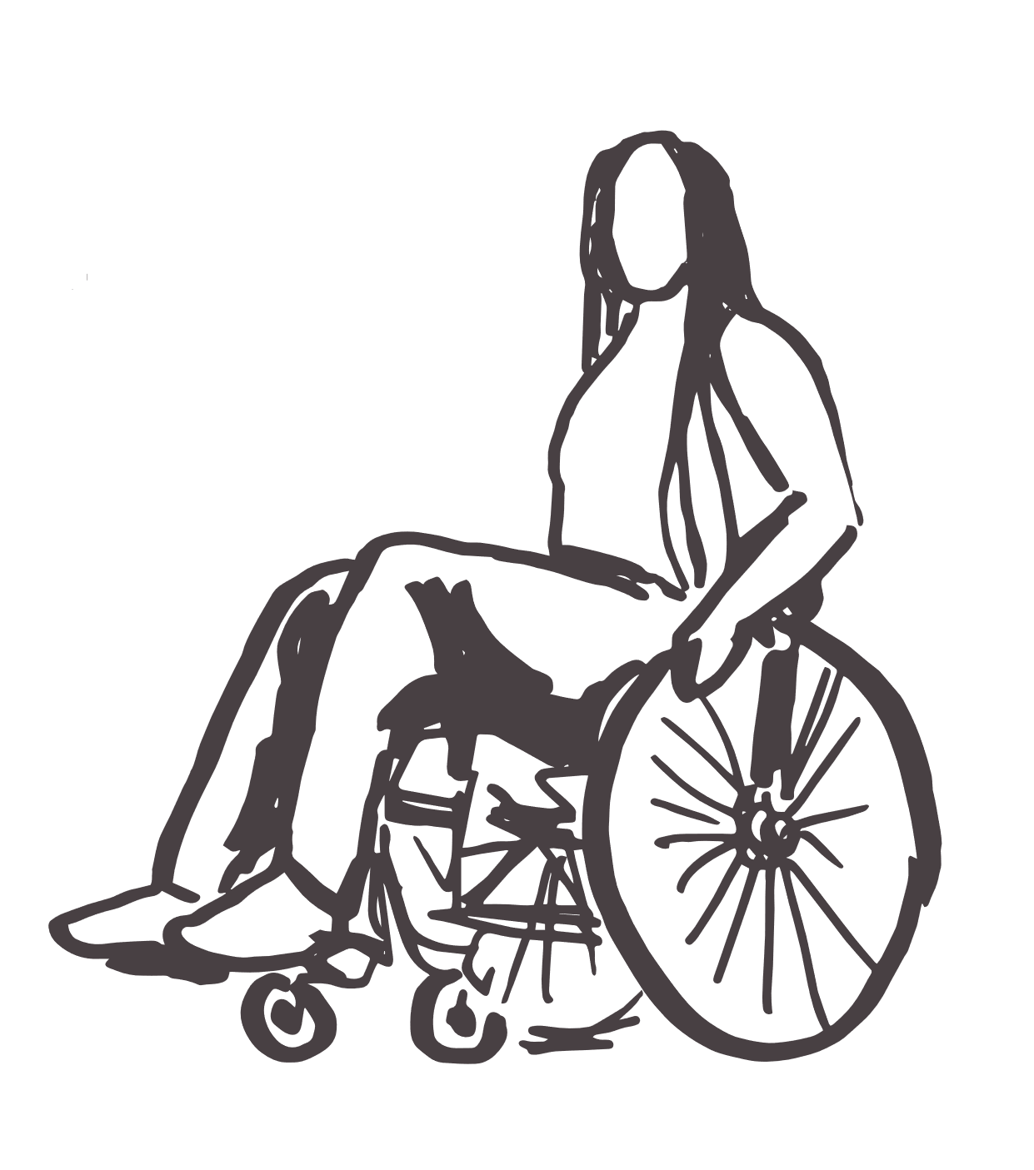
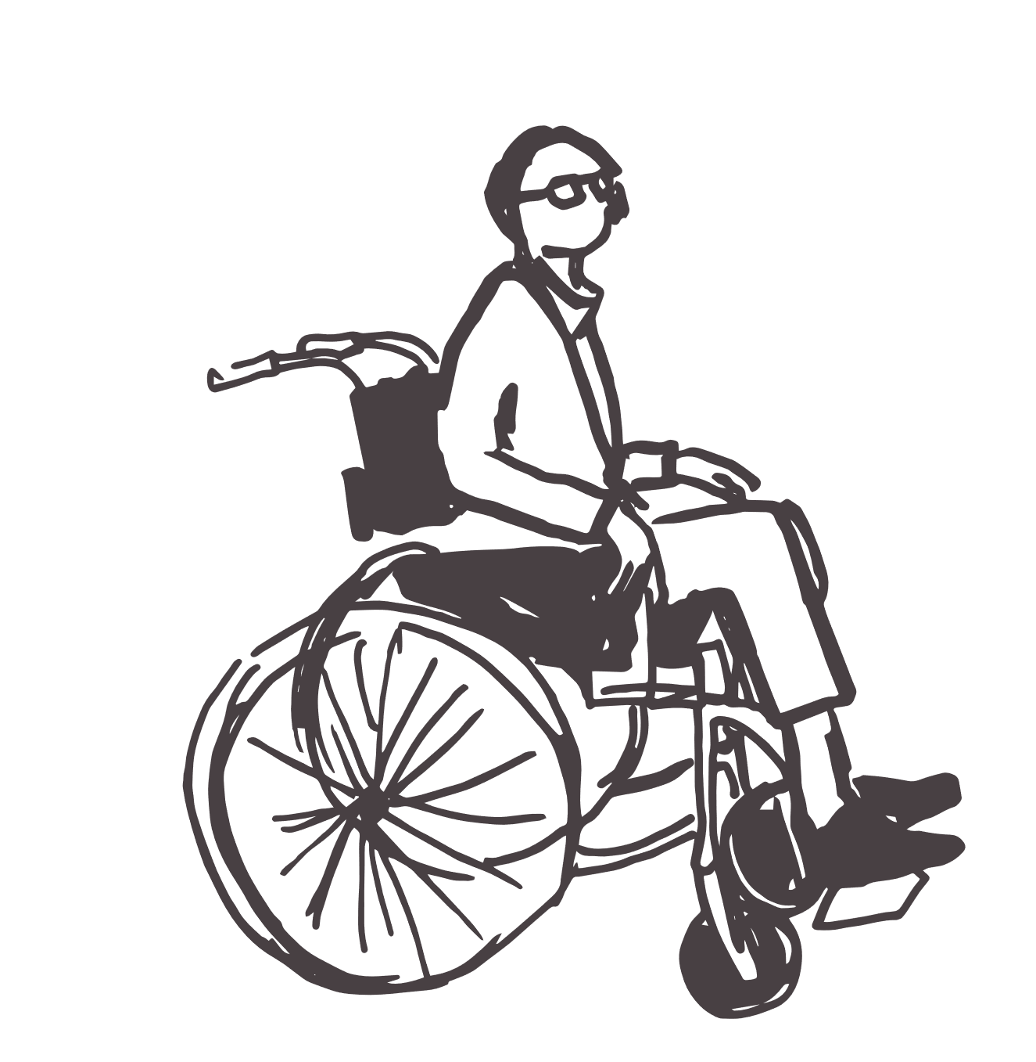
Activity levels by disability
Source: Sport England Active Lives, Children and Young People survey 2017-18 to 2021-22
Measure: An average of 60 minutes or more a day, either at school or outside school (everywhere), an average of 30 minutes a day in school and an average of 30 minutes a day outside of school
Data is for: West of England
Notes:
This question was added to the survey in 19-20 which is why there are only 3 years of data
Sample Size 17-18 18-19 19-20 20-21 21-22
Has limiting disability 0 0 32 30 78
No limiting disability 0 0 463 383 585

Slide 22


Activity levels by ethnicity
Source: Sport England Active Lives, Children and Young People survey 2017-18 to 2021-22
Measure: An average of 60 minutes or more a day, either at school or outside school (everywhere), an average of 30 minutes a day in school and an average of 30 minutes a day outside of school
Data is for: West of England
Notes:
Sample Size 17-18 18-19 19-20 20-21 21-22
White British 1031 737 360 451 668
Minority ethnic group 335 199 240 88 187

Slide 23
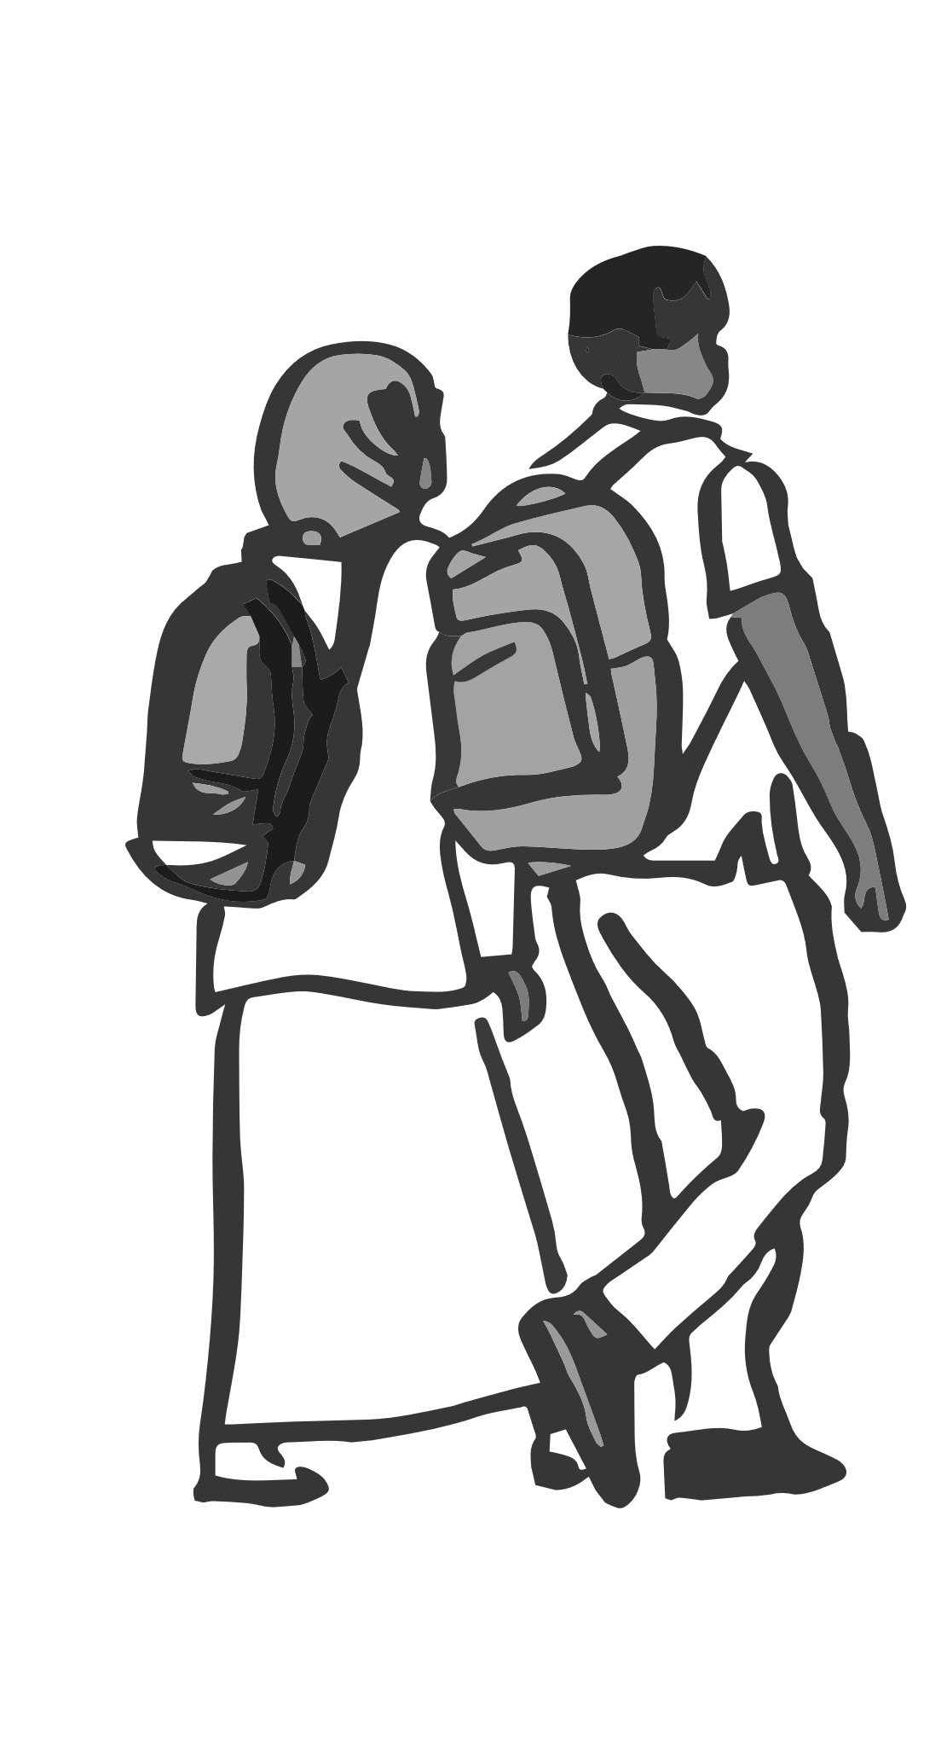
Our CYP from Black and other ethnic communities experience considerably lower levels of activity
Source: Sport England Active Lives, Children and Young People survey 2017-18 to 2021-22 combined
Measure: An average of 60 minutes or more a day, either at school or outside school (everywhere)
Data is for: West of England
Notes:
Sample size
White British 3247
White Other 217
Asian 251
Black 162
Mixed 258
Other ethnicity 161

Slide 24
Activity levels by Income deprivation affecting children
Source: Sport England Active Lives, Children and Young People survey 2017-18 to 2021-22
Measure: An average of 60 minutes or more a day, either at school or outside school (everywhere), an average of 30 minutes a day in school and an average of 30 minutes a day outside of school
Data is for: West of England
Notes:
This is derived from the Index of Income Deprivation Affecting Children (IDACI) which comes under the Index of Multiple Deprivation Outputs but is based on income source data only. It is matched onto the data using the postcode of the school attended by the pupil.
Deciles 1-4 are grouped as ‘deprived’ deciles 8-10 are grouped as ‘affluent’
Sample Size 17-18 18-19 19-20 20-21 21-22
1 - 4 most deprived 381 222 429 139 339
8 - 10 least deprived 778 197 214 330 457

Slide 25
Family affluence has the biggest impact on physical activity levels
Source: Sport England Active Lives, Children and Young People survey 2017-18 to 2021-22 combined
Measure: An average of 60 minutes or more a day, either at school or outside school (everywhere)
Data is for: West of England

Slide 26
Activity levels at school by demographic group
Source: Sport England Active Lives, Children and Young People survey 2017-18 to 2021-22 combined
Measure: An average of 30 minutes or more a day at school
Data is for: West of England

Slide 27
Activity levels outside school by demographic group
Source: Sport England Active Lives, Children and Young People survey 2017-18 to 2021-22 combined Measure: An average of 30 minutes or more a day outside of school
Data is for: West of England

Slide 28
Activity levels by demographic groups
17-18
19-20
21-22
17-18
19-20
21-22
17-18
19-20
21-22
Source: Sport England Active Lives, Children and Young People survey 2017-18 to 2021-22
Measure: An average of 60 minutes or more a day, either at school or outside school (everywhere)
Data is for: West of England

Slide 29
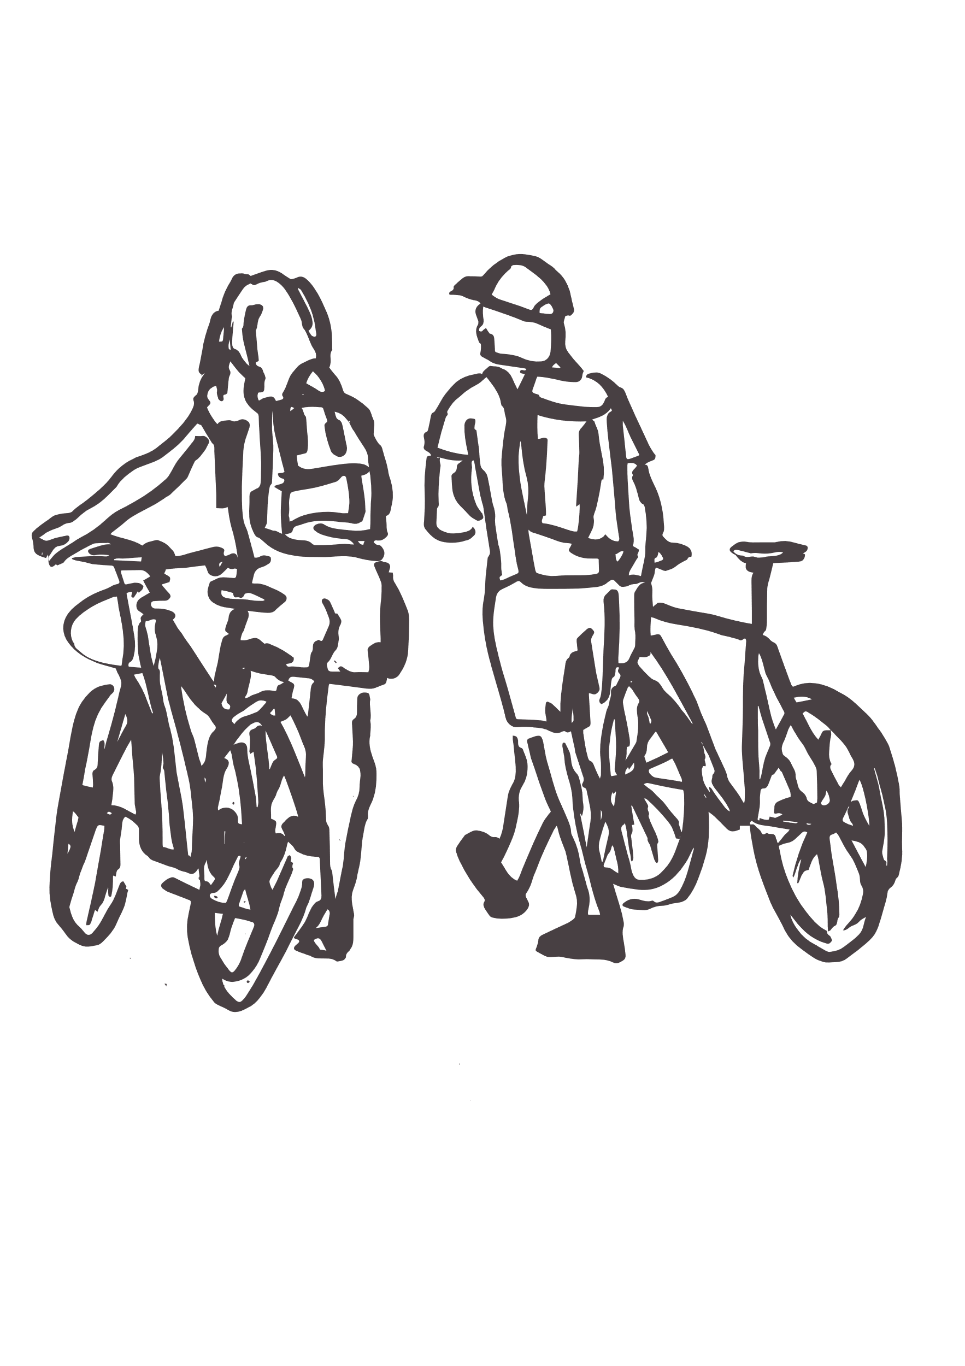
Second demographics
To help us further understand physical activity behaviour, we have split year groups by a second demographic – for example year 3-6 by gender
Again, we have combined 5 years of data to boost the sample size for these groups
Year groups are broken down by gender and family affluence

Slide 30
Gender inequalities between primary and secondary school age children
Source: Sport England Active Lives, Children and Young People survey 2017-18 to 2021-22 combined
Measure: An average of 60 minutes or more a day, either at school or outside school (everywhere)
Data is for: West of England
Notes:
Sample
Year 3-6 Boy 673
Year 3-6 Girl 714
Year 7-11 Boy 1430
Year 7-11 Girl 1447
England values
Years 3-6 Girl 40%
Years 3-6 Boy 46%
Years 7-11 Girl 40%
Years 7-11 Boy 46%

Slide 31
Inequalities for families with varying affluence by primary and secondary school age children
Source: Sport England Active Lives, Children and Young People survey 2017-18 to 2021-22 combined
Measure: An average of 60 minutes or more a day, either at school or outside school (everywhere)
Data is for: West of England
Notes:
Sample
Year 3-6 Low FAS 256
Year 3-6 Medium FAS 827
Year 3-6 High FAS 363
Year 7-11 Low FAS 485
Year 7-11 Medium FAS 1750
Year 7-11 High FAS 741
England values
Years 3-6 Low FAS 34%
Years 3-6 Medium FAS 43%
Years 3-6 High FAS 53%
Years 7-11 Low FAS 36%
Years 7-11 Medium FAS 42%
Years 7-11 High FAS 52%

Slide 32


Triple demographics
In this section we show analysis by all three of the following demographics:
Year groups
Gender
Family affluence
Again, we have combined 5 years of data to boost the sample size for these groups

Slide 33
Inequalities are greater for younger children, particularly those from high affluence families
Source: Sport England Active Lives, Children and Young People survey 2017-18 to 2021-22 combined
Measure: An average of 60 minutes or more a day, either at school or outside school (everywhere)
Data is for: West of England
Notes:
Sample
Boy Girl
Year 3-6 Low FAS 113 127
Year 3-6 Medium FAS 408 382
Year 3-6 High FAS 187 155
Year 7-11 Low FAS 200 196
Year 7-11 Medium FAS 809 758
Year 7-11 High FAS 307 337

Slide 34
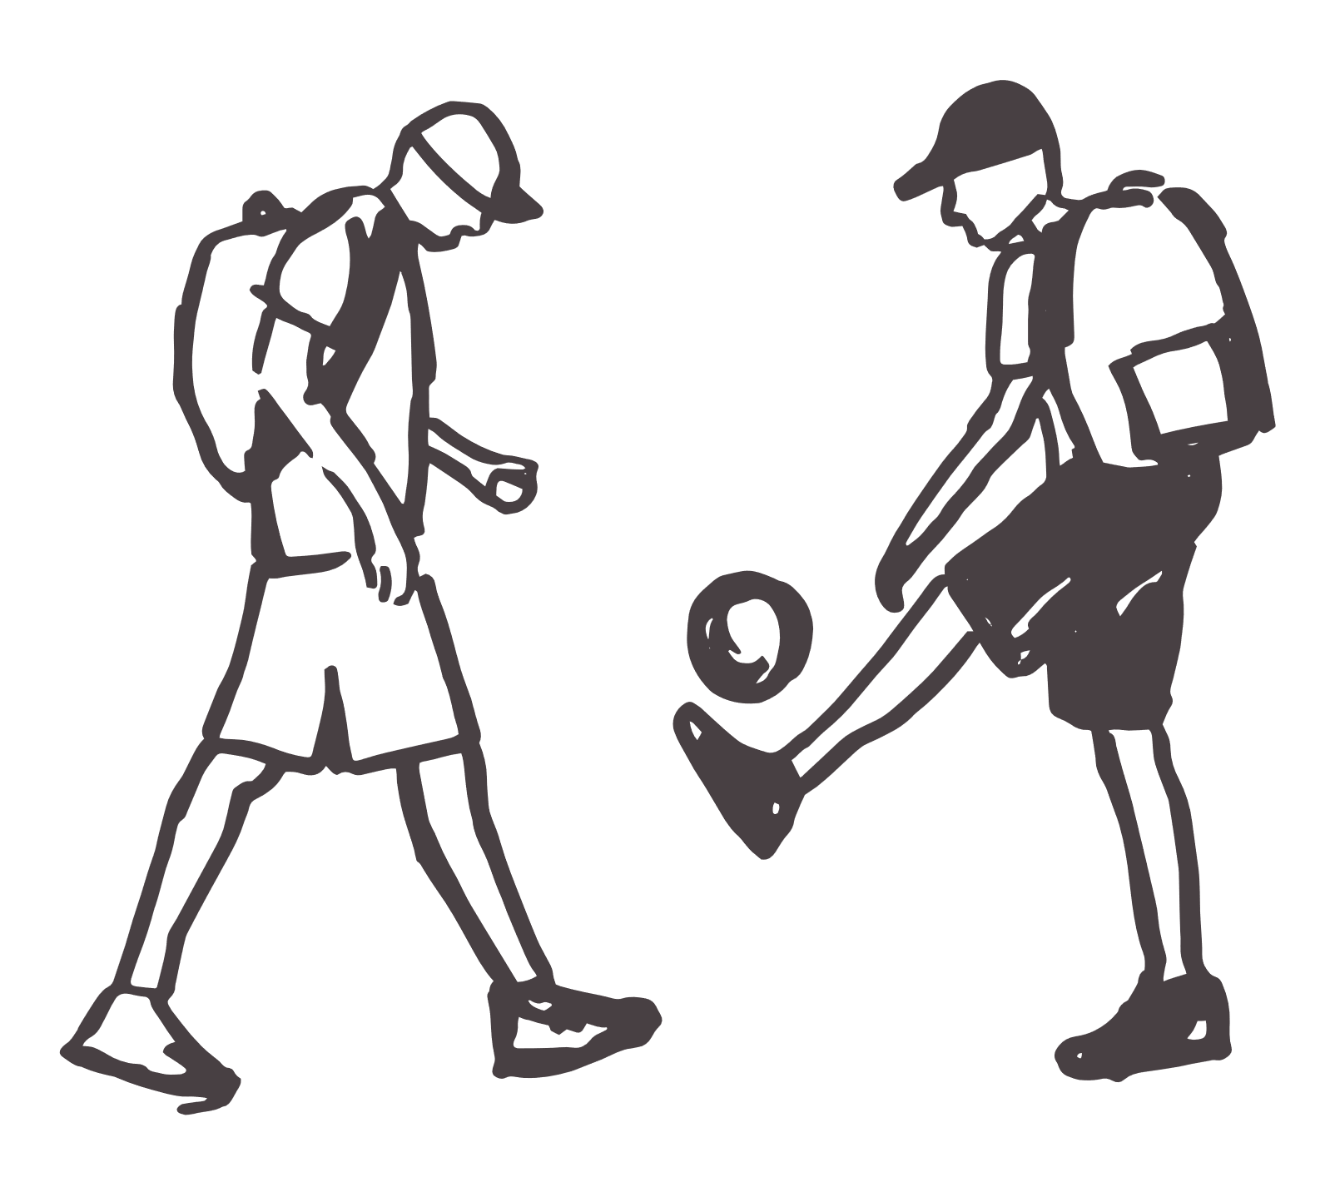
Activities
In this section we analyse the types of activities children and young people were doing in a given week
Data is for any duration, with at least moderate intensity

Slide 35
Fitness activities have dropped from pandemic highs but been consistent for the last 2 years. However, fitness still only makes up a small proportion of active minutes
Time spent dancing peaked last year. However, active minutes have dropped back to pre- pandemic levels
Active play was disrupted by the pandemic but has been recovering ever since. However, time spent playing has still got a way to go before getting back to pre- pandemic highs
Fitness activities
Dance
Active play
Source: Sport England Active Lives, Children and Young People survey 2017-18 to 2021-22
Measure: An average of 60 minutes or more a day, either at school or outside school (everywhere)
Data is for: West of England
Notes:
17-18 18-19 19-20 20-21 21-22
Sporting Activities 220 243 172 174 199
Walking for travel 61 81 78 103 109
Active Play 82 114 59 80 90
Walking for leisure 30 38 60 72 55
Dance 32 27 30 34 28
Fitness Activities 19 19 40 25 25
Cycling & Scooting 23 27 24 19 22

Slide 36

The pandemic positively affected the amount of time children and young people spent walking for travel.
Sporting activities continue to contribute the most active minutes despite being less than they were pre-pandemic
The amount of time spent walking for leisure peaked last year but is now declining
Cycling and scooting has remained consistently low
Walking for leisure
Walking for travel
Sporting activities
Source: Sport England Active Lives, Children and Young People survey 2017-18 to 2021-22
Measure: An average of 60 minutes or more a day, either at school or outside school (everywhere)
Data is for: West of England
Notes:
17-18 18-19 19-20 20-21 21-22
Sporting Activities 220 243 172 174 199
Walking for travel 61 81 78 103 109
Active Play 82 114 59 80 90
Walking for leisure 30 38 60 72 55
Dance 32 27 30 34 28
Fitness Activities 19 19 40 25 25
Cycling & Scooting 23 27 24 19 22

Slide 37


Overall, the amount of time children spend being active is increasing
Sporting activities
The importance of walking for children and young people has grown
Particularly
walking for travel
Walking for travel
Active play
Walking for leisure
Dance
Fitness activities
Cycling & scooting
Source: Sport England Active Lives, Children and Young People survey 2017-18 to 2021-22
Measure: An average of 60 minutes or more a day, either at school or outside school (everywhere)
Data is for: West of England
Notes:
17-18 18-19 19-20 20-21 21-22
Sample Sizes 1397 1021 660 583 947
Total Active Minutes 491 576 488 525 551
17-18 18-19 19-20 20-21 21-22
Sporting Activities 220 243 172 174 199
Walking for travel 61 81 78 103 109
Active Play 82 114 59 80 90
Walking for leisure 30 38 60 72 55
Dance 32 27 30 34 28
Fitness Activities 19 19 40 25 25
Cycling & Scooting 23 27 24 19 22
England
17-18 18-19 19-20 20-21 21-22
Sport 214.1 233.4 197.4 175.1 208.0
Active Play 91.9 104.9 84.8 82.3 97.3
Walk travel 67.5 69.0 87.1 84.5 96.6
Walk leisure 34.3 38.8 45.4 56.9 44.2
Dance 29.4 29.4 27.9 39.6 34.5
Fitness 14.3 14.5 18.3 24.1 24.5
Cycle & Scoot 20.8 22.1 22.8 22.1 17.8

Slide 38

The story so far…

Slide 39
Summary
50.4% of all CYP do not meet the recommended physical activity guidelines
However active rates in the West of England are at an all time high (49.6%)
In the last 12 months girls activity rates have dropped 3pp, whilst boys activity rates have increased by 10pp. Boys active rates are now 5pp higher
When we combined 5 years worth of data
Activity rates are highest for young people in school years 5-9
Those from Black (41%) and ‘other ethnic groups’ (32%) are least likely to be active
Girls activity rates ( 45%) are 4pp lower than boys (49%)
Children from deprived areas (43%) are less likely to be active
Time spent walking for travel is at an all time high whilst Sporting Activities have not recovered to the pre covid rates

